Slide 1

Green Pace
Security Policy Presentation
Developer: Linus Joseph

Slide 2
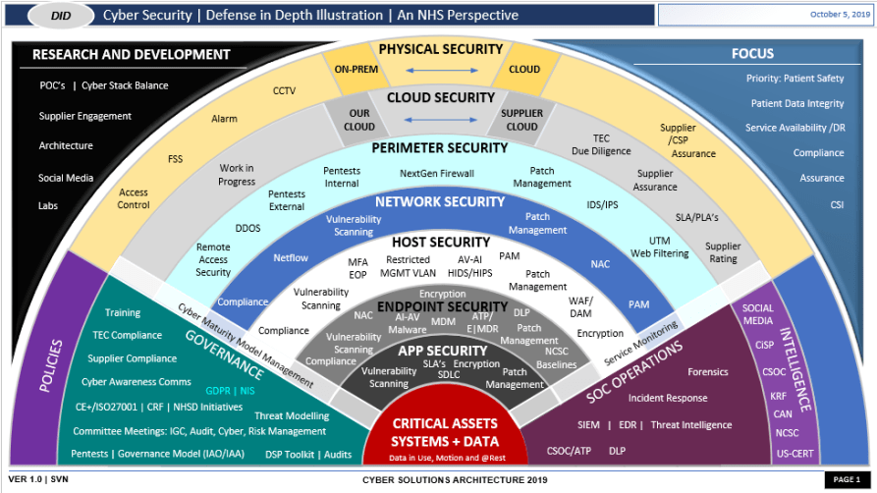
OVERVIEW: DEFENSE IN DEPTH

Slide 3
THREATS MATRIX
Likely High probably of threats occurring, for example: Phishing & Ransomeware | Priority These threats requiring robust and swift action
Low priority Threats that have little relevancy to the security of the system | Unlikely Security threats that are least likely to happen
There are a multitude of threats that can try to locate the vulnerabilities in a given securely coded system. These threats need to be addressed in the order of magnitude to the damage they can inflict. The Threat Matrix shows how these should be address.

Slide 4
10 PRINCIPLES
Validate input
Heed Compiler Warnings
Architect and Design for Security Policies
Keep it Simple
Default Deny
Adhere to the principle of least privilege
Sanitize data sent to other systems
Practice defense in depth
Use effective quality assurance techniques
Adopt a secure coding standard

Slide 5
CODING STANDARDS
Variable name conventions
Class and function naming conventions
Indentation
Avoid deep nesting
Portability
Limit line length
Reusability and scalability
Testing
Clear and concise comments
File and folder structure

Slide 6
ENCRYPTION POLICIES
Encryption in flight – data that is in the process of being sent/received
Encryption at rest – data that is being stored.
Encryption in use – data that is secured at every stage in its life cycle

Slide 7
TRIPLE-A POLICIES
Authentication – be sure the intended person is accessing the data.
Authorization - be sure the authenticated person is accessing the data
Accounting – be sure that any data that is being accessed is monitored and recorded accordingly

Slide 8
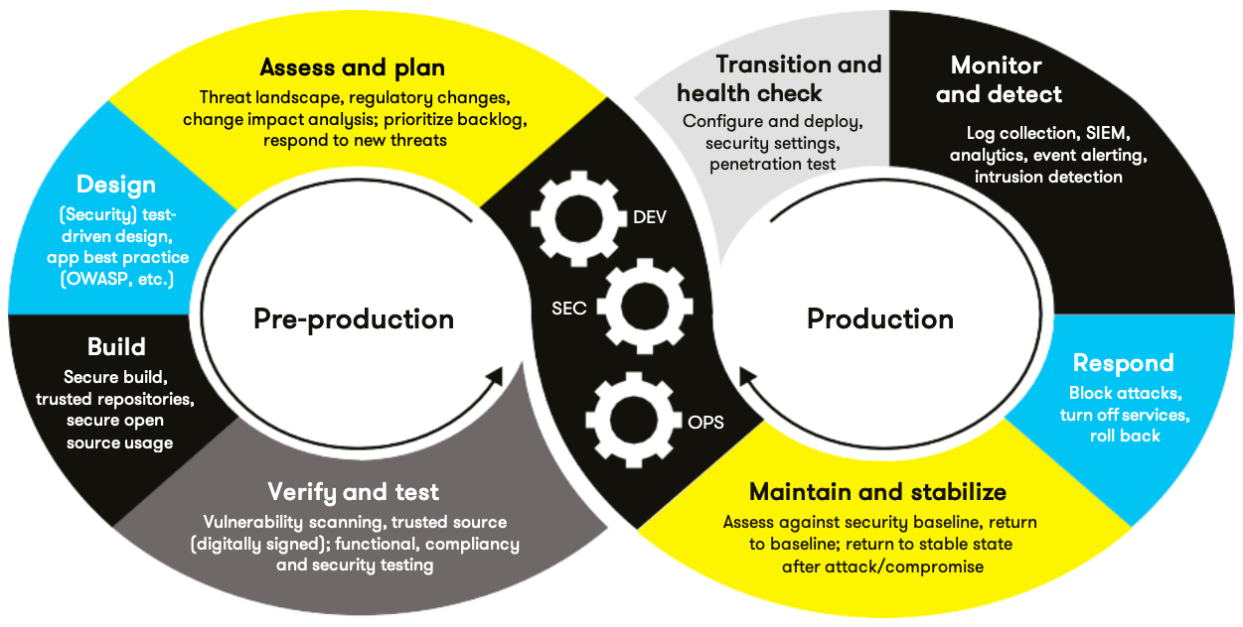
AUTOMATION SUMMARY

Slide 9
TOOLS
  Whitesource
  Logz.io
  GitLab

Slide 10
RISKS AND BENEFITS
Prevention is better than the cure
Less security breech’s
Layered Defense

Slide 11
RECOMMENDATIONS
    Tools have vulnerabilities
    How to deal with intruders

Slide 12
CONCLUSIONS
Validate input
Heed Compiler Warnings
Architect and Design for Security Policies
Keep it Simple
Default Deny
Adhere to the principle of least privilege
Sanitize data sent to other systems
Practice defense in depth

Slide 13

REFERENCES
Grant, A. (Sept, 20 2020). 10 Basic Programming Principles Every Programmer Must Know. Retrieved from: makeuseof.com/tag/basic-programming-principles/
https://owasp.org/
Goldstein, A. (June 7, 2021). 9 Best DevSecOps Tools To Intergrate Throughout the DevOps Pipeline. Retrieved from: https://www.whitesourcesoftware.com/resources/blog/devsecops-tools/
Schiela, R. (May 02, 2018) Top 10 Secure Coding Practices. Retrived from: https://wiki.sei.cmu.edu/confluence/display/seccode/Top+10+Secure+Coding+Practices

